Slide 1


Slide 2
Examination and Diagnosis of the Shoulder
Dr. Brian Patterson

Slide 3


Thank You !
Wonderful Meal
Drinks and Fun

Slide 4
Background
Born and raised in Corpus Christi
Graduate of WB Ray High School
UT undergraduate
Medical School & Orthopaedic Residency UTMB Houston

Slide 5
Shoulder Exam
History
  Important in orthopaedics, includes mechanism of injury, athletic injury, over use etc…
Physical exam
  The shoulder is a complicated joint and provocative testing guides your diagnosis

Slide 6
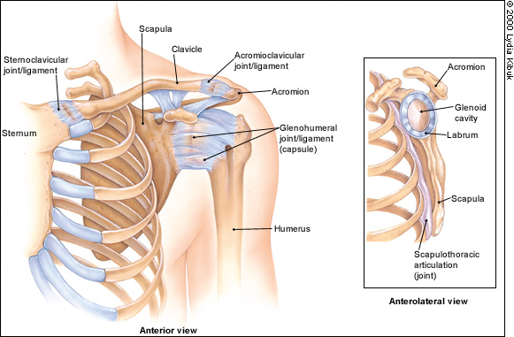
Anatomy

Slide 7
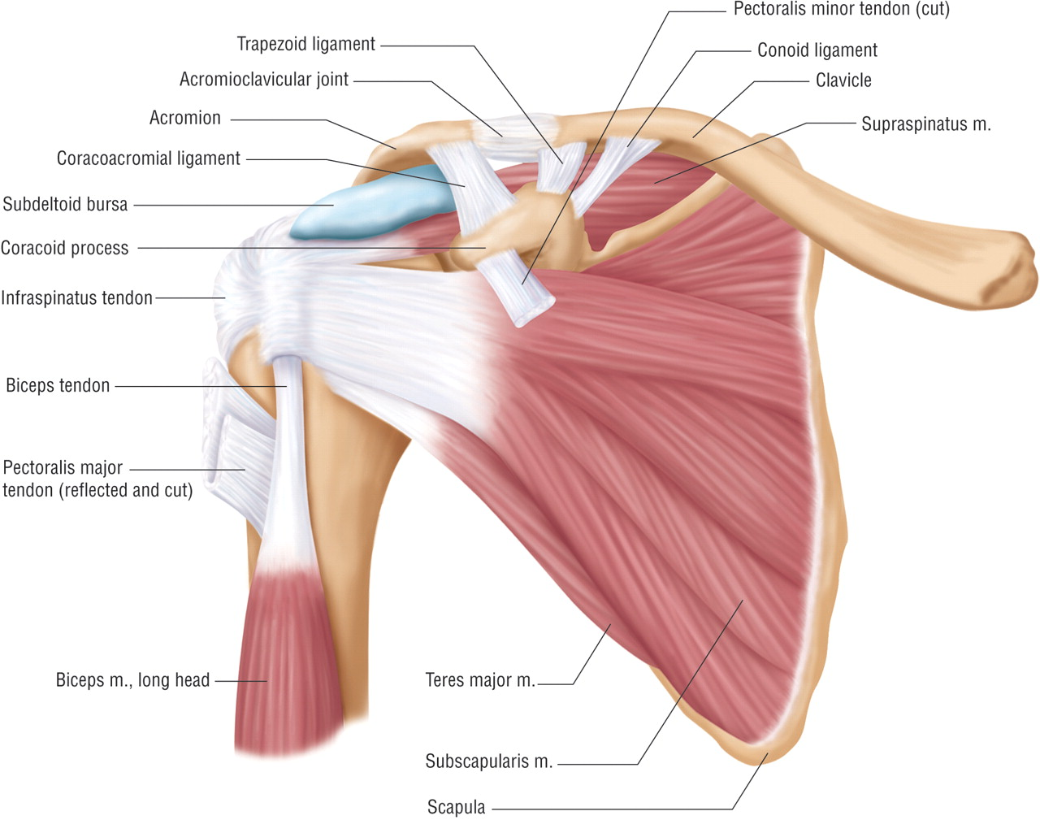
Anatomy

Slide 8
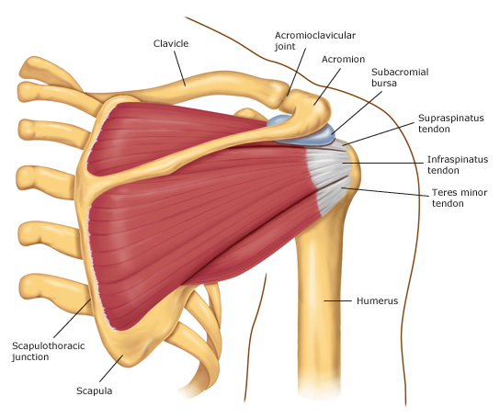
Anatomy

Slide 9
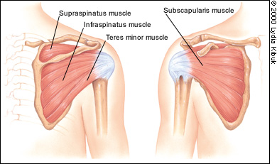
The 4 Rotator Cuff Muscles

Slide 10
Shoulder Exam
Get the history – What happened, when did it start
Ask where it hurts (have the patient point to the spot)
Get them to show you what movements make it hurt
What position relieves the pain
Bilateral upper extremities should be examined and compared to detect differences in both strength and ROM

Slide 11
Palpation
Clavicle
AC joint
Bicipital groove and biceps tendon
Anterior and posterior glenohumeral joint
Coracoid process
Scapula

Slide 12
Range of Motion
Normal Findings
Forward flexion to 180 degrees
Extend behind back 40 degrees
Abduction 180 degrees (arms slightly supinated)
Adduction to 0 degrees (arms at side of body)

Slide 13
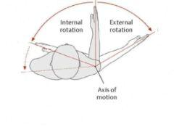
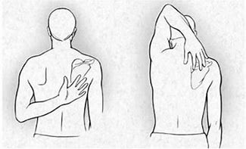
Range of Motion
External Rotation (elbows at 90) 90 degrees
Internal rotation (elbows at 90) 70 degrees
Internal Rotation - Apley Scratch Test
  reach behind head - should reach opposite superior medial scapula
  Reach behind back should reach opposite inferior medial scapula

Slide 14
Strength
Measured on a 5 point scale and compared to opposite side (1 – 5)
Supraspinatus
Empty can test – arms out thumbs down push up
Infraspinatus/Teres minor
External rotation – (elbows at 90) push out
Subscapularis
  Resisted internal rotation
  Lift off test (arm behind back, palm out, push away from body
  Can also use Napoleon test, hand on belly, examiner attempts to pull hand off belly
Deltoid isometric (elbow at 90 degrees by the patients side)
  Anterior – push forward
  Lateral – push out & up
  Posterior – push back

Slide 15
Provocative Testing – Rotator Cuff
  Drop Arm test (massive RC tear)
    supraspinatus tear, raise arm to side as high as possible, slowly lower to 90 and hold, with complete rotator cuff tear, arm will drop
  Impingement Test (Subacromial Bursitis/RC tear)
    area under acromioclavicular joint where the rotator cuff muscle traverse, Neer sign – pronate arm, passively forward flex, any pain is a positive, this pinches the rotator cuff tendons/muscles under the coracoacromial arch
  Hawkins Test (Subacromial Bursitis/RC tear)
    forward flex arm to 90, bend elbow to 90, internal rotate, force humerus greater tuberosity into the coracoacromial arch – impinges supraspinatus

Slide 16
Provacative Testing Labrum
  Speeds Test (biceps tendon or labral pathology)
    forward flex with palm up, push up with resistance
  O’Briens Test (specific for labral tear)
    arm forward flexed, adduct about 20, internally rotate to thumb down, pt to resist downward pressure, next externally rotate to thumb up, pt to resist downward pressure, positive is pain or painful clicking with thumb down, relieved with thumb up
Crank Test (test for labral pathology)
    forward flex arm, elbow to 90, internally and externally rotate while applying (axial load) pressure towards pt through the glenohumeral joint. Positive is pain, catching, or painful clicking

Slide 17
Provacative Testing Labrum
  Apprehension Test (labral tear/glenohumeral joint stability)
    stabilize scapula, arm to abducted to 90, externally rotate humerus, positive indicates anterior instability, subluxation, or dislocation
    Relocation Test – performed after a positive apprehension test, in the same position, apply anterior pressure over proximal humerus, positive is a look of relief
    Anterior Release Test – Same position as the relocation test, anterior shoulder stability, positive is pt report of pain or instability upon release of pressure
  Sulcus Sign Test (test for glenohumeral laxity)
    pull arm down proximal to elbow while palpating the acromioclavicular joint with other hand

Slide 18
Diagnosis
Subacromial Bursitis/Tendonitis =
  Impingment Syndrome
Genohumeral OA
Labral Tear
AC joint OA
Biceps Tendonitis
Always keep cervical issues in the back of your mind (especially if it is bilateral shoulder pain)

Slide 19
Something not Related to the Shoulder!
5 minutes Regarding advancements to Total Knee Replacement Technology
Significantly improving patient outcomes

Slide 20
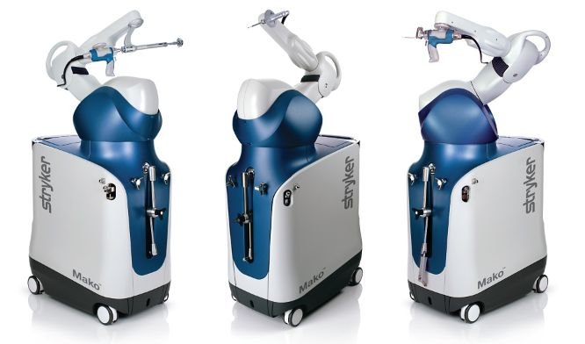
Total Knee Replacement Technology
Stryker Mako - Robotic Assisted Total Knee Arthroplasty

Slide 21
Mako Protocol
Surgical candidate who has failed conservative therapy and wishes to proceed with surgery
Medical clearance obtained
CT of the knee is ordered for preoperative planning = Radiology and Imaging
CT 3D modeling in robot allows for determining optimal implant size as well as position, and alignment for each individual patient

Slide 22
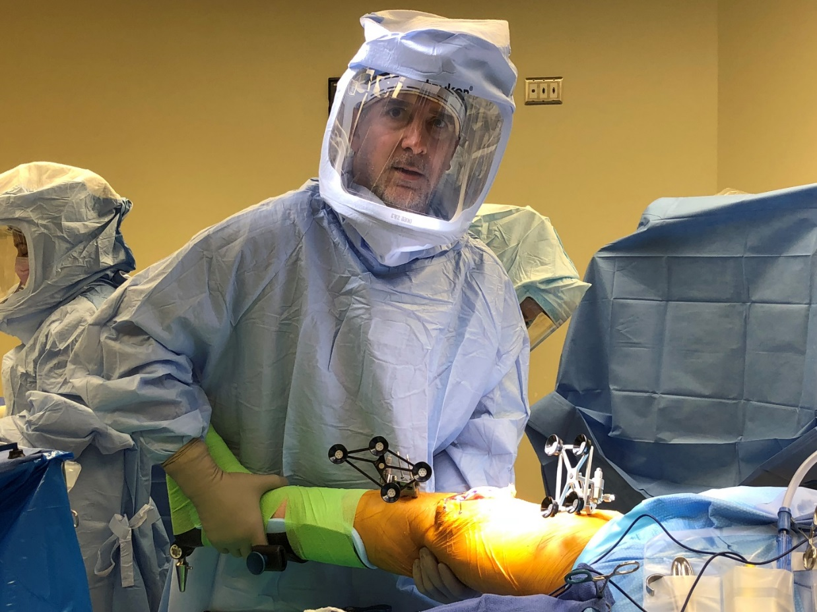
Dr. Patterson and his Robot

Slide 23
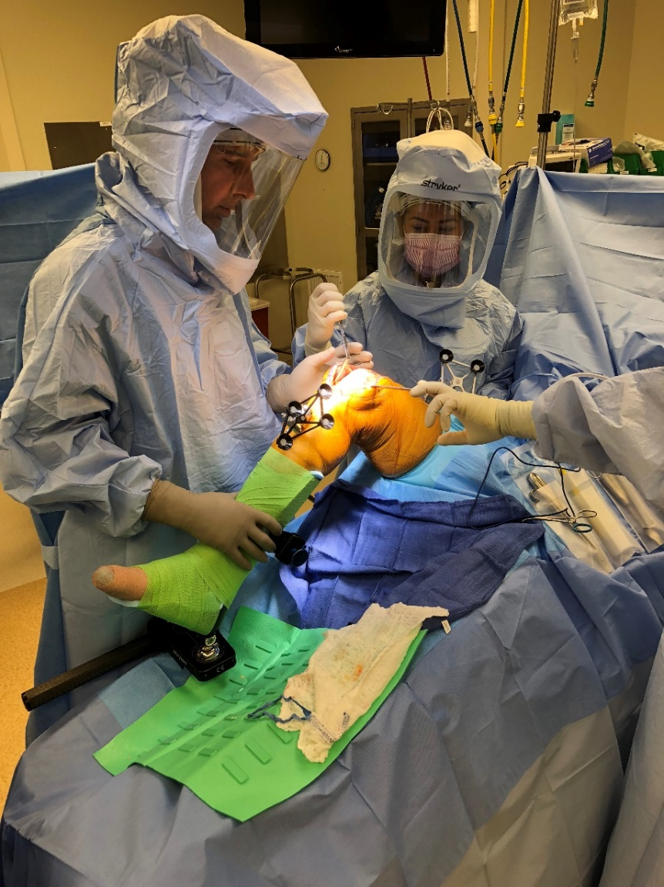

Slide 24
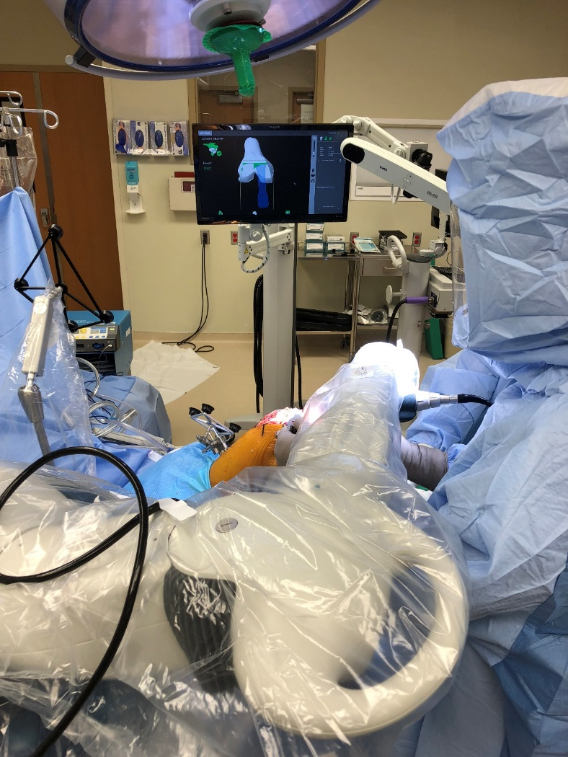

Slide 25
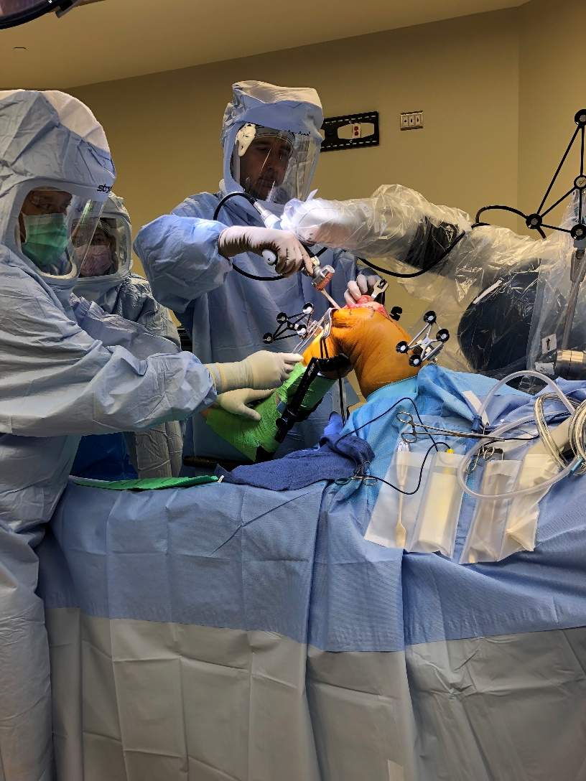

Slide 26
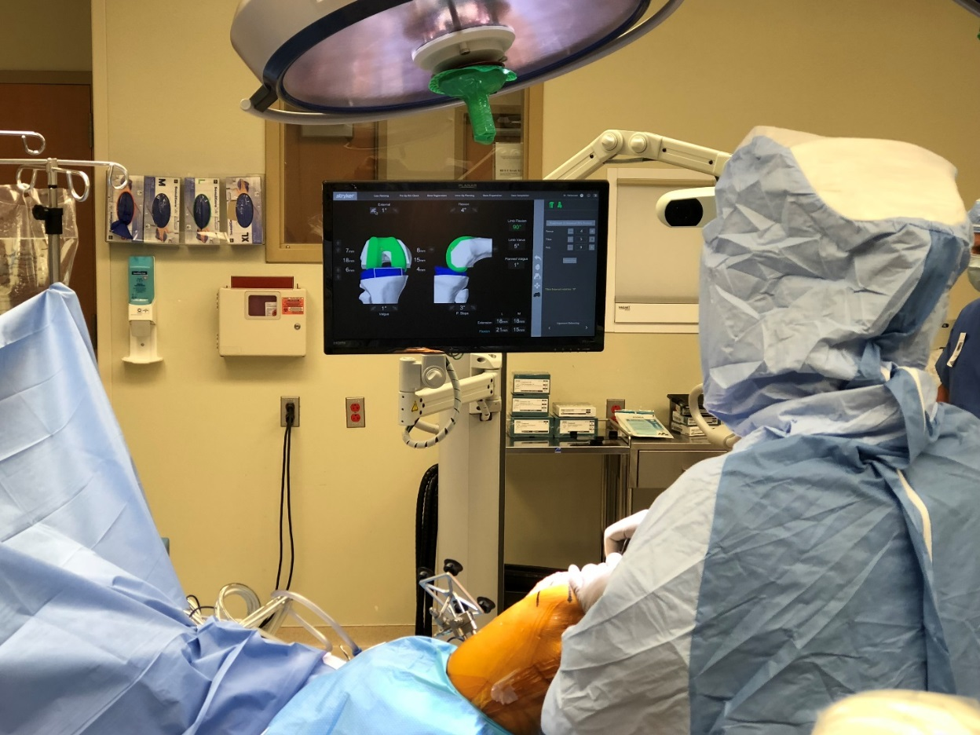

Slide 27



Proud to be the Official
Orthopaedic Team Physicians
for the

